Slide 1

A Project Review Meeting on Student Grievance Redressal Portal
By
Name : Param Manasvi roll: 2520030072
Name : Burla Vida Swetha roll: 2520030100
Team Number: 1
Under the guidance of
Pavitra Duggineni
Associate Professor
Department of Computer Science and Engineering
Koneru Lakshmaiah Education Foundation (Deemed to be University estd. u/s. 3 of the UGC Act, 1956) Off-Campus: Bachupally-Gandimaisamma Road, Bowrampet, Hyderabad, Telangana - 500 043. Phone No: 7815926816, www.klh.edu.in

Slide 2
Outline of the Presentation
Abstract
Introduction
Problem Statement
Project Flow Diagram
Objectives with Justification
Modules[Frontend web pages]
Expected Outcomes of the Proposed Work
Conclusion
References

Slide 3
Abstract
Student Grievance Redressal Portal is a full web-based platform that allows students to submit grievances, officers to review and resolve complaints, and administrators to monitor the entire grievance resolution process. It is built using React.js, Node.js, Express.js, and MySQL. The system provides a centralized platform for grievance registration, status tracking, officer assignment, and resolution management. Features such as role-based dashboards, grievance tracking, real-time synchronization between users, secure data storage, and administrative monitoring improve transparency and efficiency in handling student complaints. The platform eliminates manual grievance processing and provides a structured workflow for students, officers, and administrators.

Slide 4
Introduction
Educational institutions receive various grievances related to academics, infrastructure, hostel facilities, examinations, and administration. Traditional grievance handling methods often involve paperwork, delayed responses, and lack of transparency.
Student Grievance Redressal Portal addresses these challenges by providing a centralized web-based platform where students can submit grievances, track complaint status, and receive updates. Officers can manage and resolve grievances efficiently, while administrators can monitor the overall grievance handling process. The system improves communication, accountability, and transparency within the institution.

Slide 5
Problem Statement
Student grievances are often managed through manual procedures such as written applications, emails, or direct reporting. These approaches make it difficult to track complaint status, maintain records, and ensure timely resolution. Students frequently lack visibility into grievance progress, while administrators face challenges in monitoring grievance handling activities.
The Student Grievance Redressal Portal aims to solve these issues by providing a centralized system with grievance submission, status tracking, officer management, administrative monitoring, and secure database storage to improve efficiency and transparency.

Slide 6
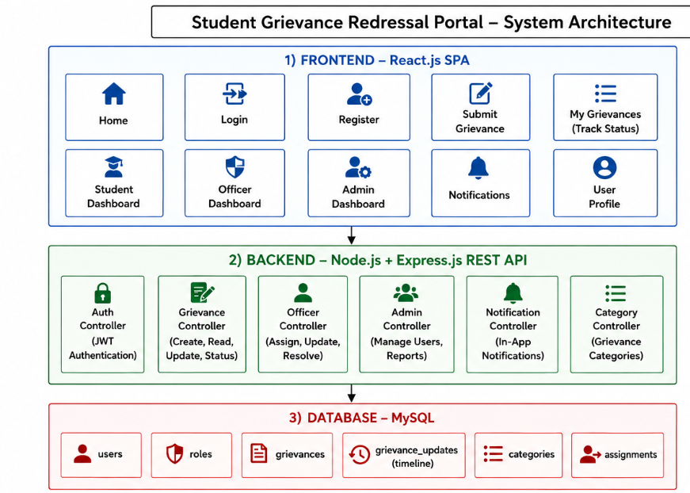
System Architecture

Slide 7
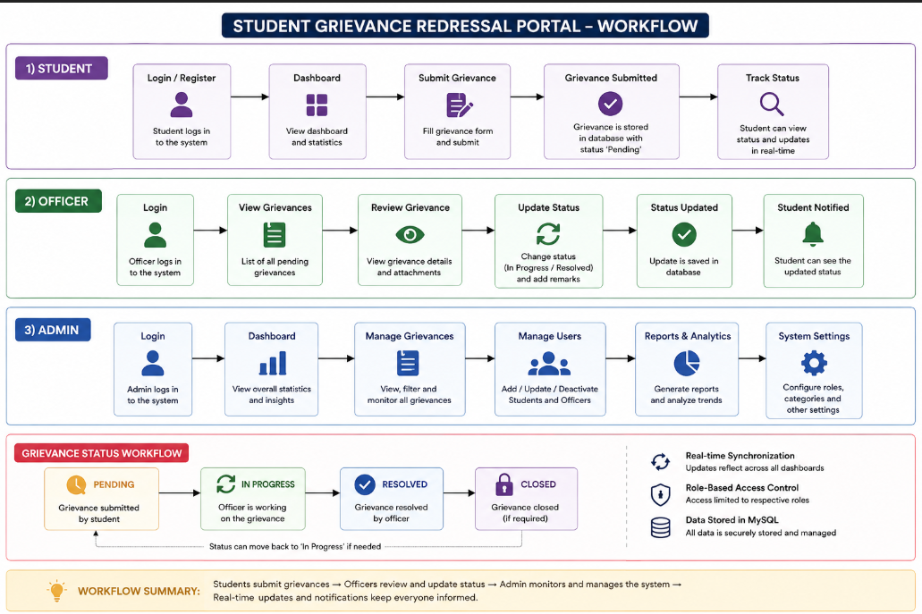
Project Flow Diagram

Slide 8
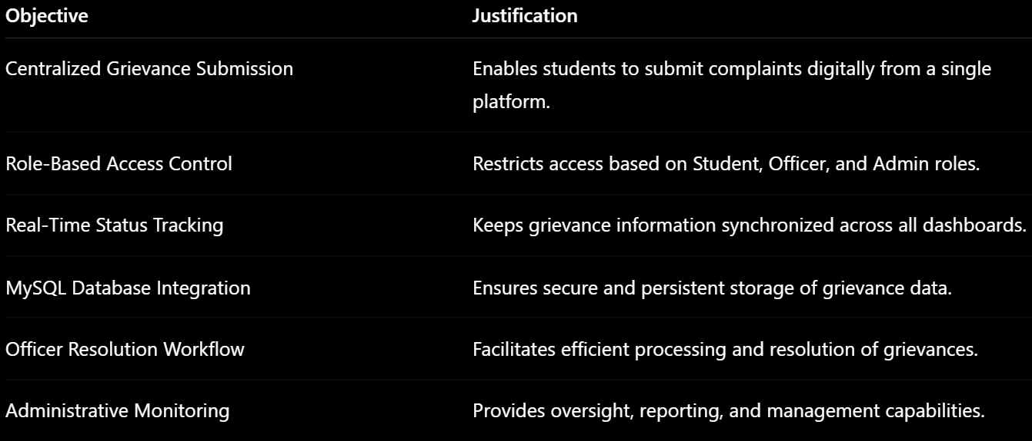
Objectives with Justification

Slide 9
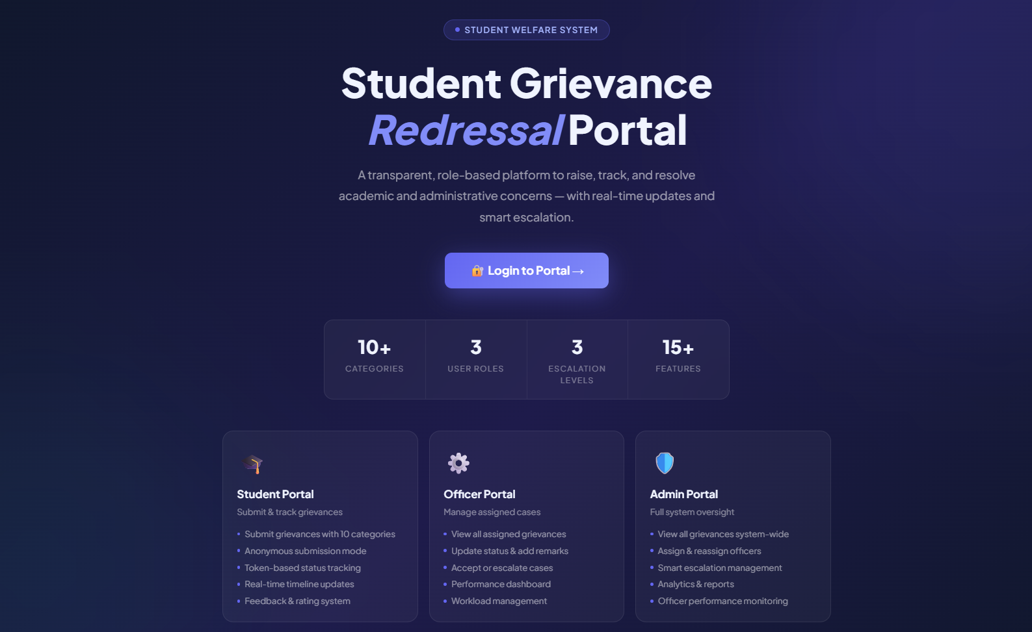
Modules [Frontend web pages]

Slide 10
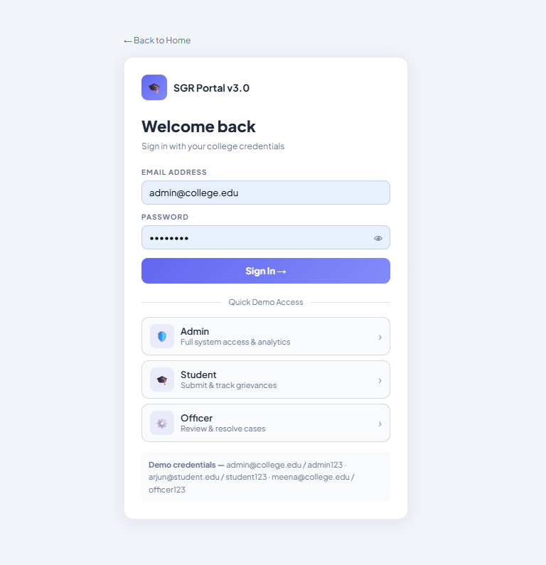
Modules [Frontend web pages]

Slide 11
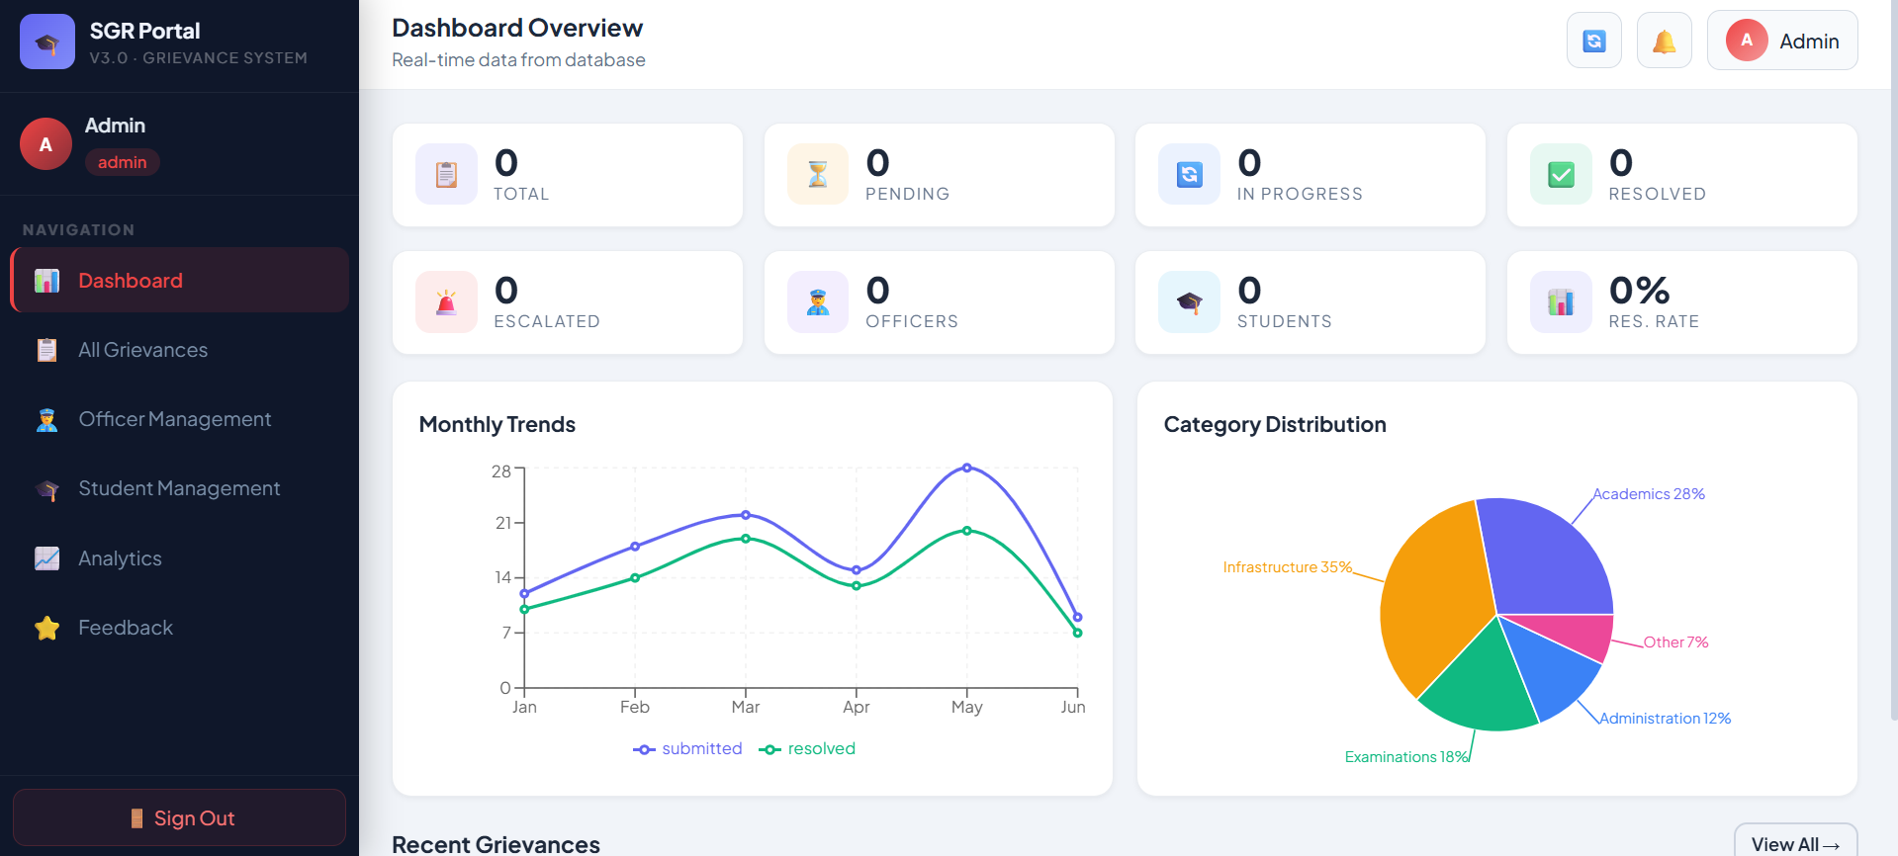
Modules [Frontend web pages]

Slide 12
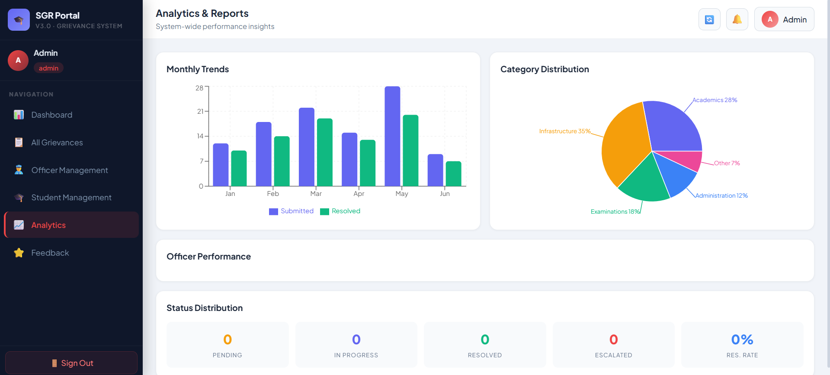
Modules [Frontend web pages]

Slide 13
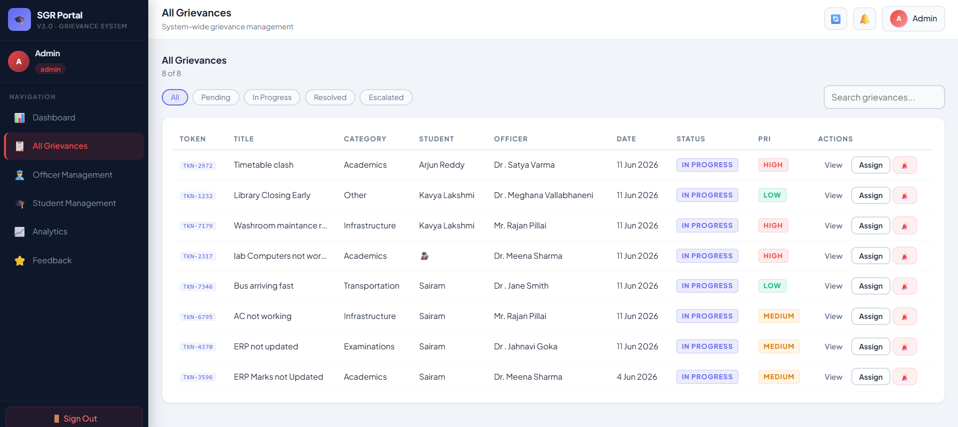
Modules [Frontend web pages]

Slide 14
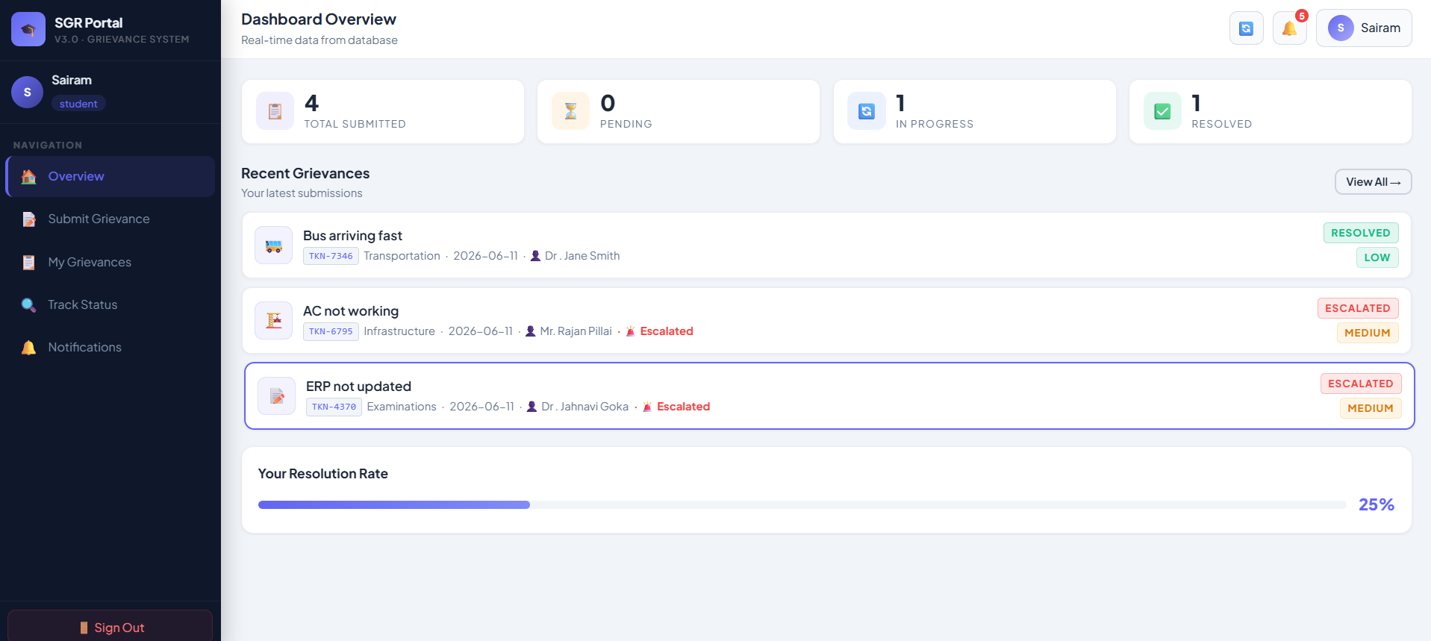
Modules [Frontend web pages]

Slide 15
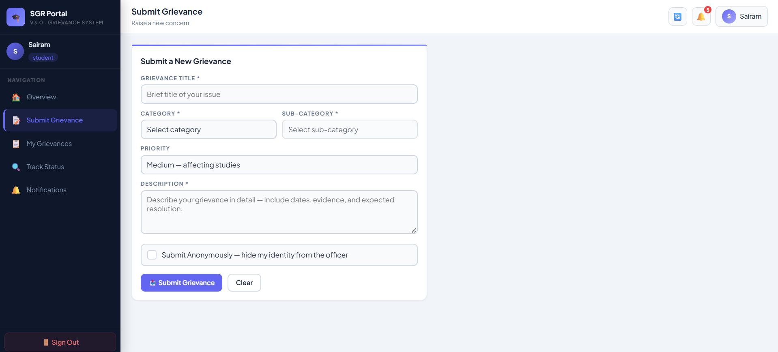
Modules [Frontend web pages]

Slide 16
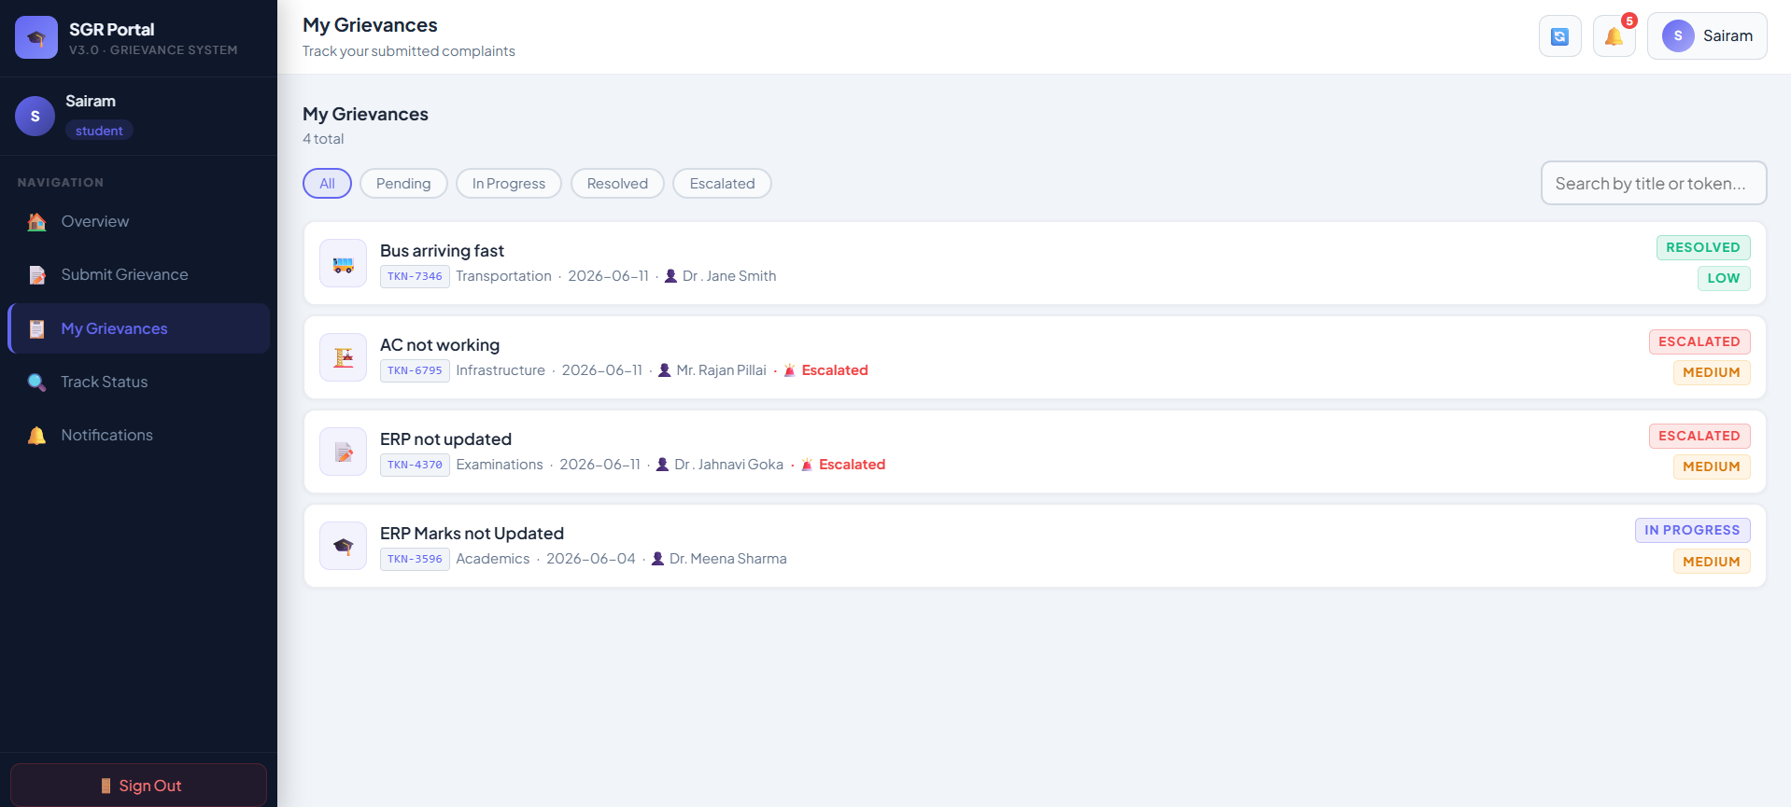
Modules [Frontend web pages]

Slide 17
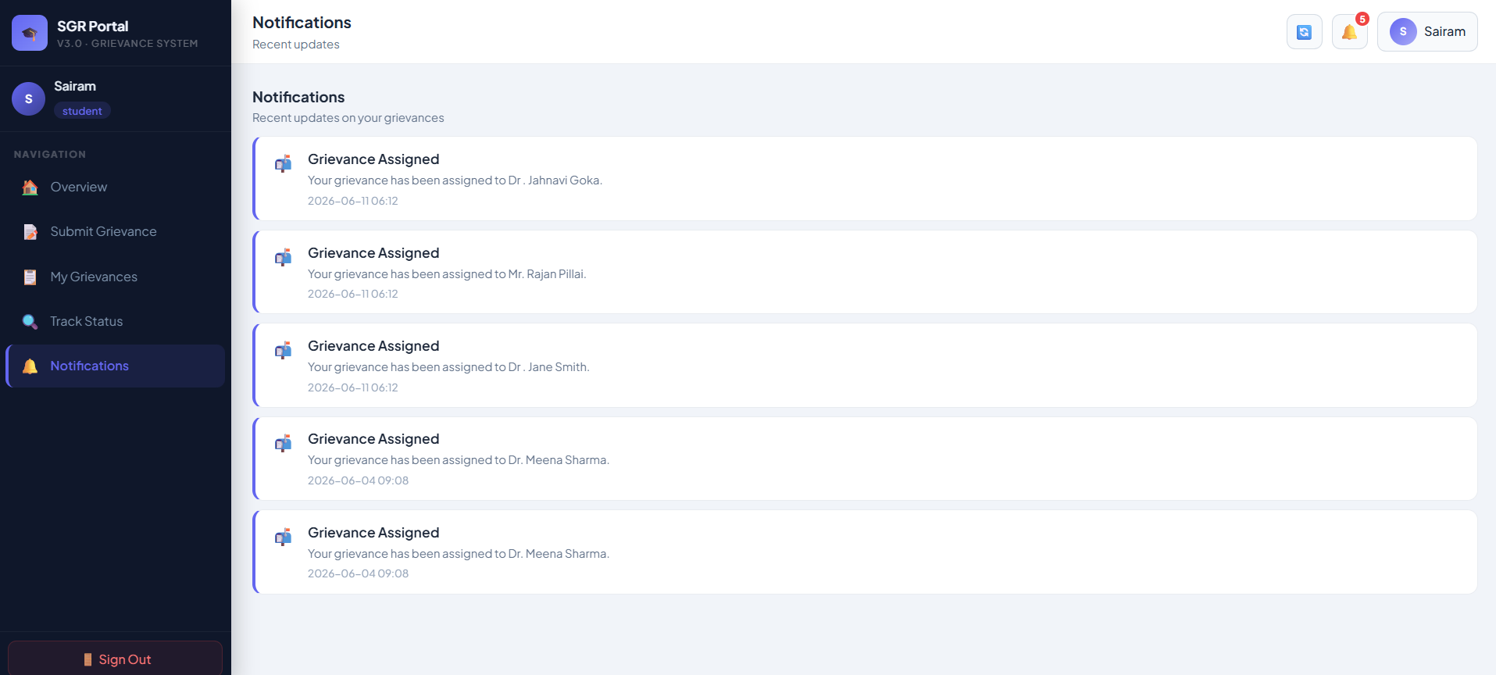
Modules [Frontend web pages]

Slide 18
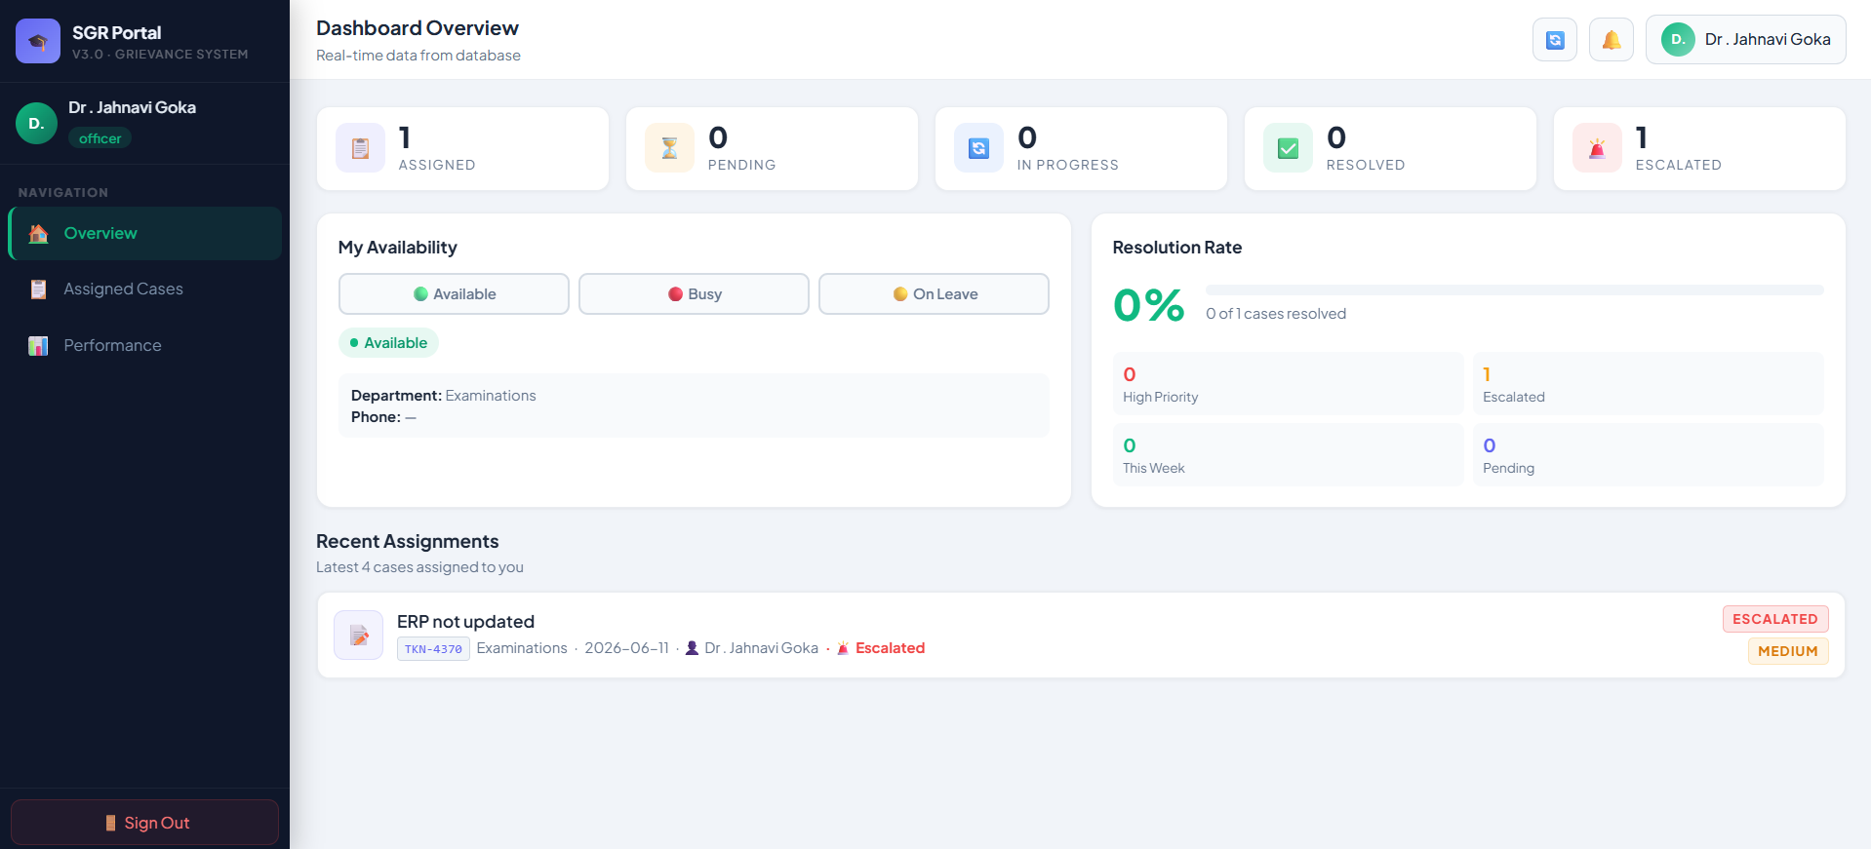
Modules [Frontend web pages]

Slide 19
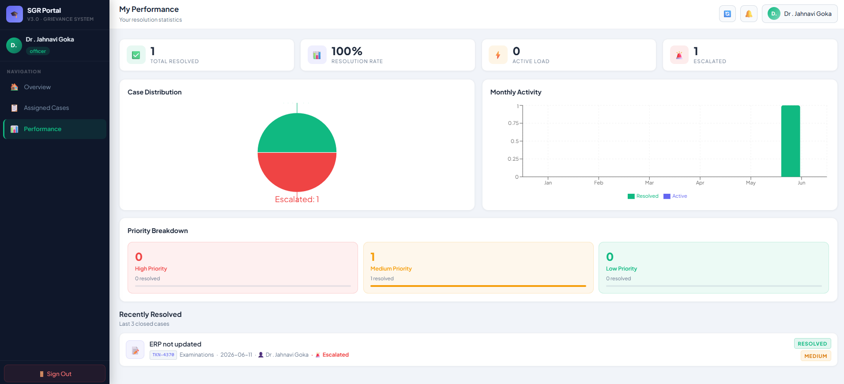
Modules [Frontend web pages]

Slide 20
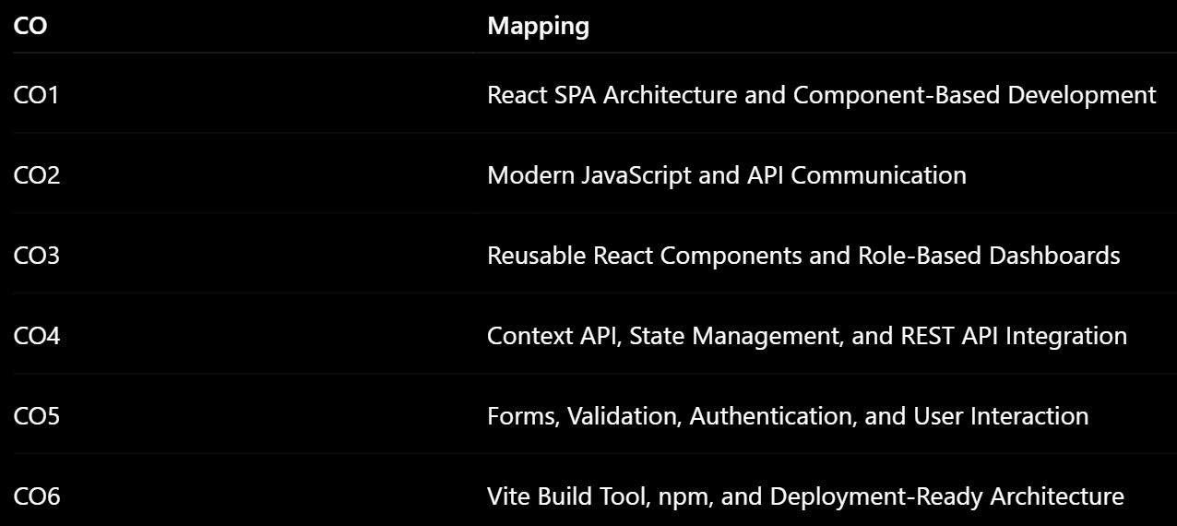
Co’s Mapping

Slide 21
Expected Outcomes of the Proposed Work
Faster grievance registration and processing.
Improved transparency in grievance resolution.
Centralized storage of grievance records.
Efficient communication between students and officers.
Status tracking for submitted grievances.
Reduced administrative workload and paperwork.
Better monitoring and reporting capabilities for administrators.
Secure storage and retrieval of grievance information using MySQL.
Scalable architecture supporting future institutional requirements.

Slide 22
Conclusion and Future Scope
Student Grievance Redressal Portal provides a centralized, secure, and user-friendly platform for managing student grievances. The system supports grievance submission, status tracking, officer management, administrative monitoring, and database-backed record maintenance. Built using React.js, Node.js, Express.js, and MySQL, the platform improves grievance resolution efficiency, transparency, and accountability while reducing manual effort.
Future enhancements may include email and SMS notifications, mobile application support, AI-based grievance categorization, advanced analytics dashboards, document upload functionality, and integration with institutional ERP systems.

Slide 23
References
React.js Documentation — https://react.dev/
Node.js Documentation — https://nodejs.org/en/docs
Express.js Documentation — https://expressjs.com/
MySQL 8.0 Reference Manual — https://dev.mysql.com/doc/
Vite Documentation — https://vitejs.dev/
React Router Documentation — https://reactrouter.com/
MDN Web Docs — https://developer.mozilla.org/
OWASP Web Security Guidelines — https://owasp.org/

Slide 24
Thank you

